Slide 1
CT004-3.5-3
Advanced Database Systems
Transaction Management

Slide 2
Learning objectives
Function and importance of transactions.
Properties of transactions.
Concurrency Control
Concurrency problem
  - Meaning of serializability.
  - How locking can ensure serializability.
  - Deadlock and how it can be resolved.

Slide 3
Transaction Support
  Transaction
  Action, or series of actions, carried out by user or application, which reads or updates contents of database.
Logical unit of work on the database.
Transforms database from one consistent state to another, although consistency may be violated during transaction.

Slide 4
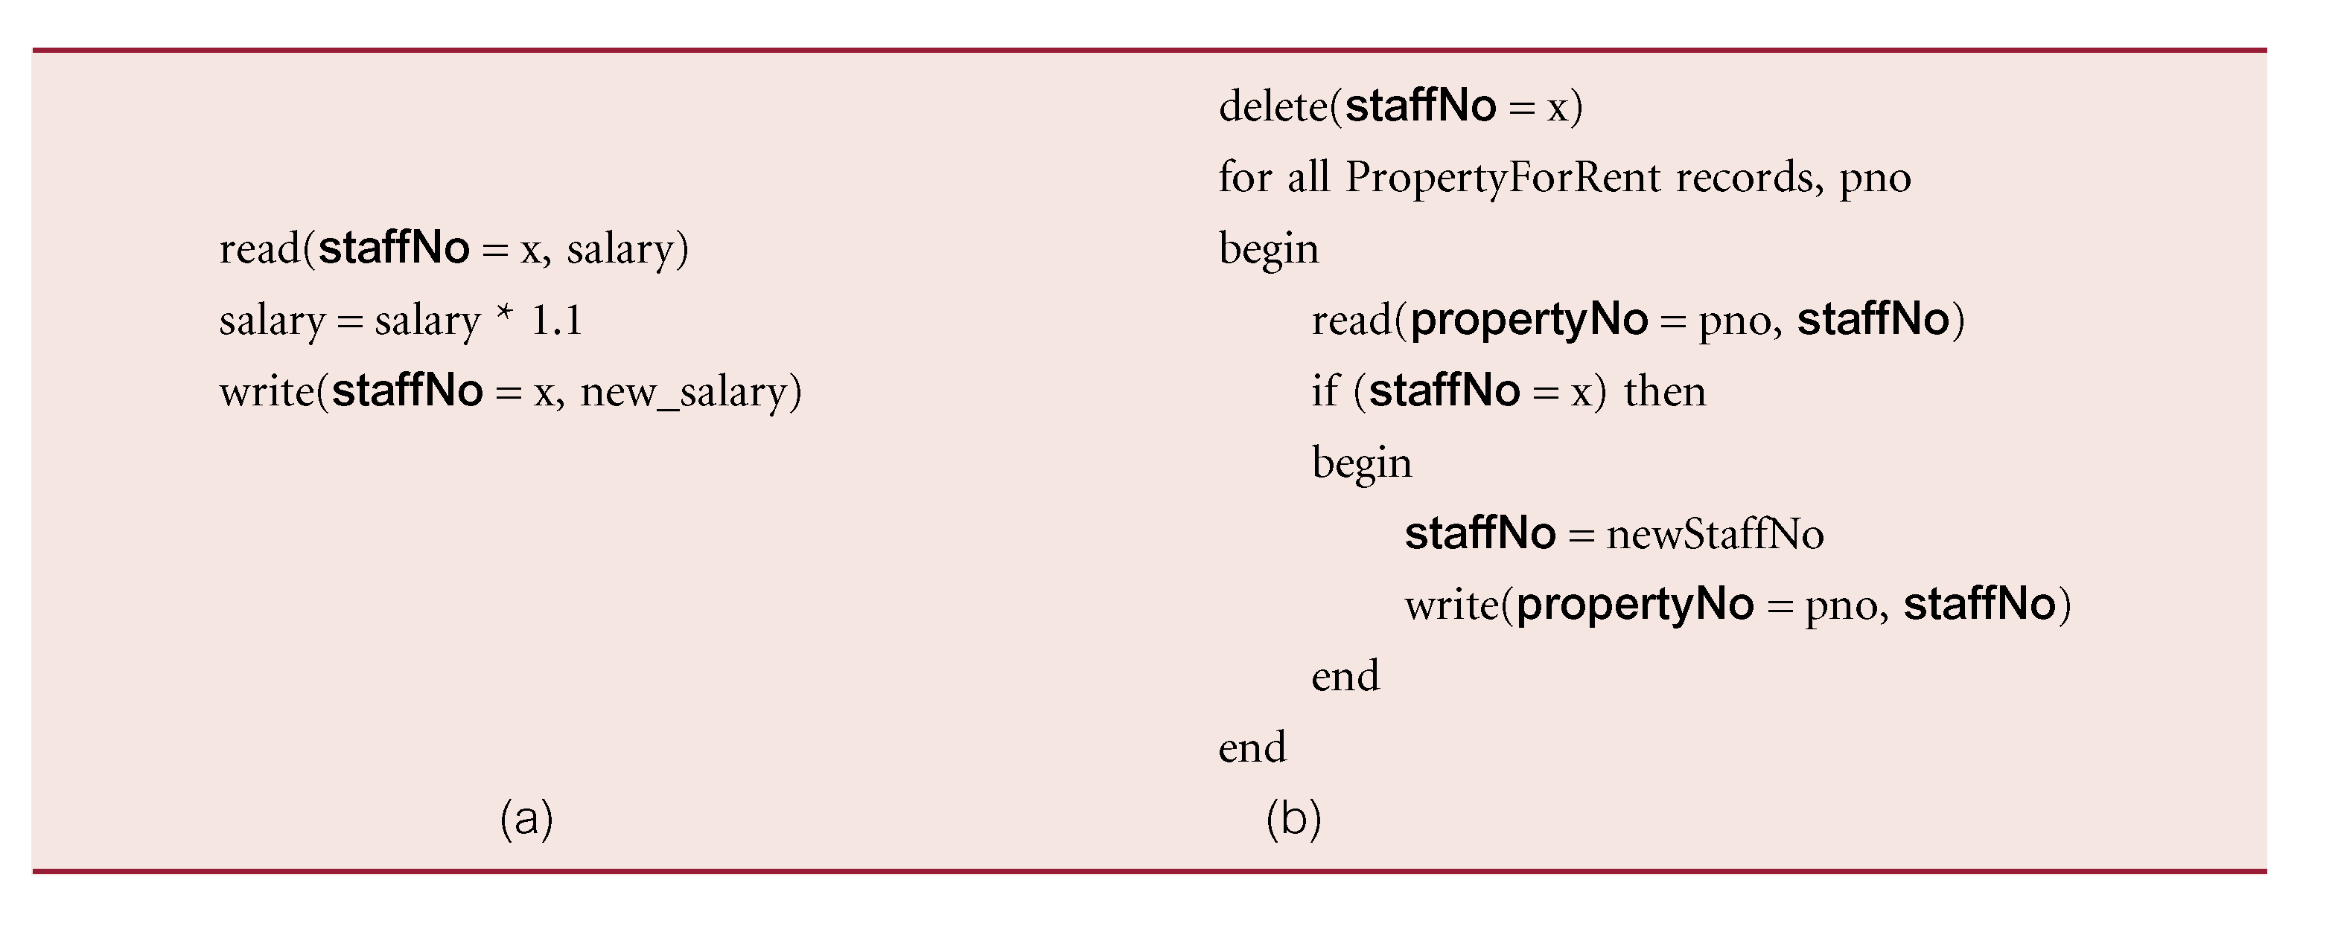
Example Transaction

Slide 5
Transaction Support
Can have one of two outcomes:
  Success - transaction commits and database reaches a new consistent state.
  Failure - transaction aborts, and database must be restored to consistent state before it started.
  Such a transaction is rolled back or undone.
Committed transaction cannot be aborted.
Aborted transaction that is rolled back can be restarted later.
Notes:
A transaction can have one of two outcomes.
If it completes successfully, the transaction is said to have committed and the database reaches a new consistent state.
if the transaction does not execute successfully, the transaction is aborted.
If a transaction is aborted, the database must be restored to the consistent state it was in before the
transaction started. Such a transaction is rolled back or undone.
A committed transaction cannot be aborted.
If we decide that the committed transaction was a mistake, we must perform another compensating transaction to reverse its effects.

Slide 6
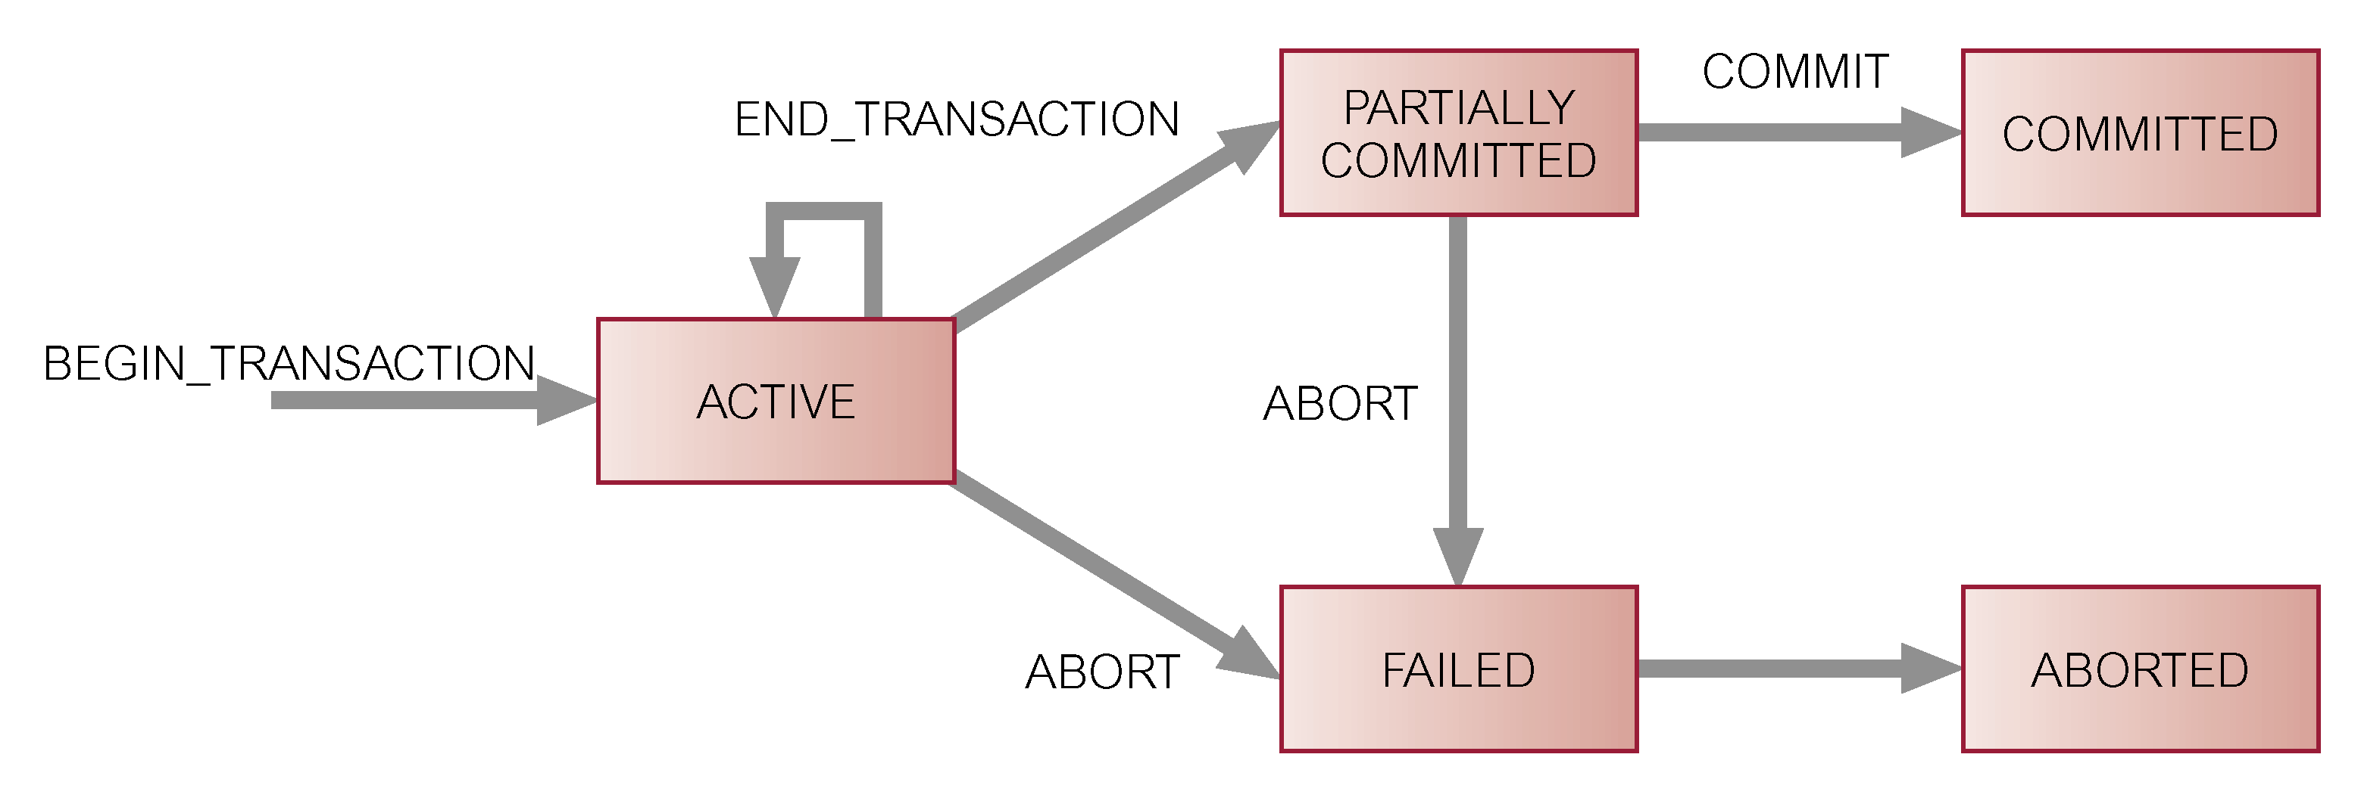
State Transition Diagram for Transaction
Notes:
Figure 20.2 shows the state transition diagram for a transaction. Note that in addition to
the obvious states of ACTIVE, COMMITTED, and ABORTED, there are two other states:
n PARTIALLY COMMITTED, which occurs after the ﬁnal statement has been executed.
At this point, it may be found that the transaction has violated serializability (see Sec-
tion 20.2.2) or has violated an integrity constraint and the transaction has to be aborted.
Alternatively, the system may fail and any data updated by the transaction may not have
been safely recorded on secondary storage. In such cases, the transaction would go into
the FAILED state and would have to be aborted. If the transaction has been successful,
any updates can be safely recorded and the transaction can go to the COMMITTED state.
n FAILED, which occurs if the transaction cannot be committed or the transaction is aborted
while in the ACTIVE state, perhaps due to the user aborting the transaction or as a result
of the concurrency control protocol aborting the transaction to ensure serializability.

Slide 7
Properties of Transactions
Four basic (ACID) properties of a transaction are:
Atomicity ‘All or nothing’ property.
Consistency Must transform database from one consistent state to another.
Isolation Partial effects of incomplete transactions should not be visible to other transactions.
Durability Effects of a committed transaction are permanent and must not be lost because of later failure.
Notes:
There are properties that all transactions should possess. The four basic, or so-called
ACID, properties of a transaction are (Haerder and Reuter, 1983):
n Atomicity The ‘all or nothing’ property. A transaction is an indivisible unit that is
either performed in its entirety or is not performed at all. It is the responsibility of the
recovery subsystem of the DBMS to ensure atomicity.
n Consistency A transaction must transform the database from one consistent state to
another consistent state. It is the responsibility of both the DBMS and the application
developers to ensure consistency. The DBMS can ensure consistency by enforcing all
the constraints that have been speciﬁed on the database schema, such as integrity and
enterprise constraints. However, in itself this is insufﬁcient to ensure consistency. For
example, suppose we have a transaction that is intended to transfer money from one
bank account to another and the programmer makes an error in the transaction logic and
debits one account but credits the wrong account, then the database is in an inconsistent
state. However, the DBMS would not have been responsible for introducing this incon-
sistency and would have had no ability to detect the error.
n Isolation Transactions execute independently of one another. In other words, the
partial effects of incomplete transactions should not be visible to other transactions. It
is the responsibility of the concurrency control subsystem to ensure isolation.
n Durability The effects of a successfully completed (committed) transaction are per-
manently recorded in the database and must not be lost because of a subsequent failure.
It is the responsibility of the recovery subsystem to ensure durability.

Slide 8
Concurrency Control
Process of managing concurrent operations on the database without having them interfere with one another.
Prevents interference when two or more users are accessing database concurrently and at least one is updating data.
Although two transactions may be correct in themselves, interleaving of operations may produce an incorrect result.

Slide 9
Need for Concurrency Control
Three examples of potential problems caused by concurrency:
  Lost update problem.
  Uncommitted dependency problem.
  Inconsistent analysis problem.

Slide 10
Lost update problem
Successfully completed update is overridden by another user.

Slide 11
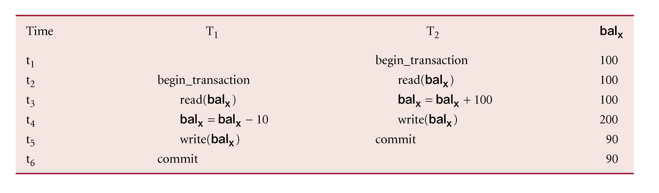
Lost Update Problem
Loss of T₂’s update avoided by preventing T₁ from reading bal_{x} until after update.
Notes:
in which transaction T 1 is executing concurrently with transaction T 2 . T 1 is withdrawing
£10 from an account with balance bal x , initially £100, and T 2 is depositing £100 into the
same account. If these transactions are executed serially, one after the other with no inter-
leaving of operations, the ﬁnal balance would be £190 no matter which transaction is
performed ﬁrst.
Transactions T 1 and T 2 start at nearly the same time, and both read the balance as £100.
T 2 increases bal x by £100 to £200 and stores the update in the database. Meanwhile, transac-
tion T 1 decrements its copy of bal x by £10 to £90 and stores this value in the database, over-
writing the previous update, and thereby ‘losing’ the £100 previously added to the balance.
The loss of T 2 ’s update is avoided by preventing T 1 from reading the value of bal x until
after T 2 ’s update has been completed.

Slide 12
Lost Update Problem
T₁ withdrawing £10 from an account with bal_{x}, initially £100.
T₂ depositing £100 into same account.
Serially, final balance would be £190.

Slide 13
Uncommitted Dependency Problem
Occurs when one transaction can see intermediate results of another transaction before it has committed.

Slide 14
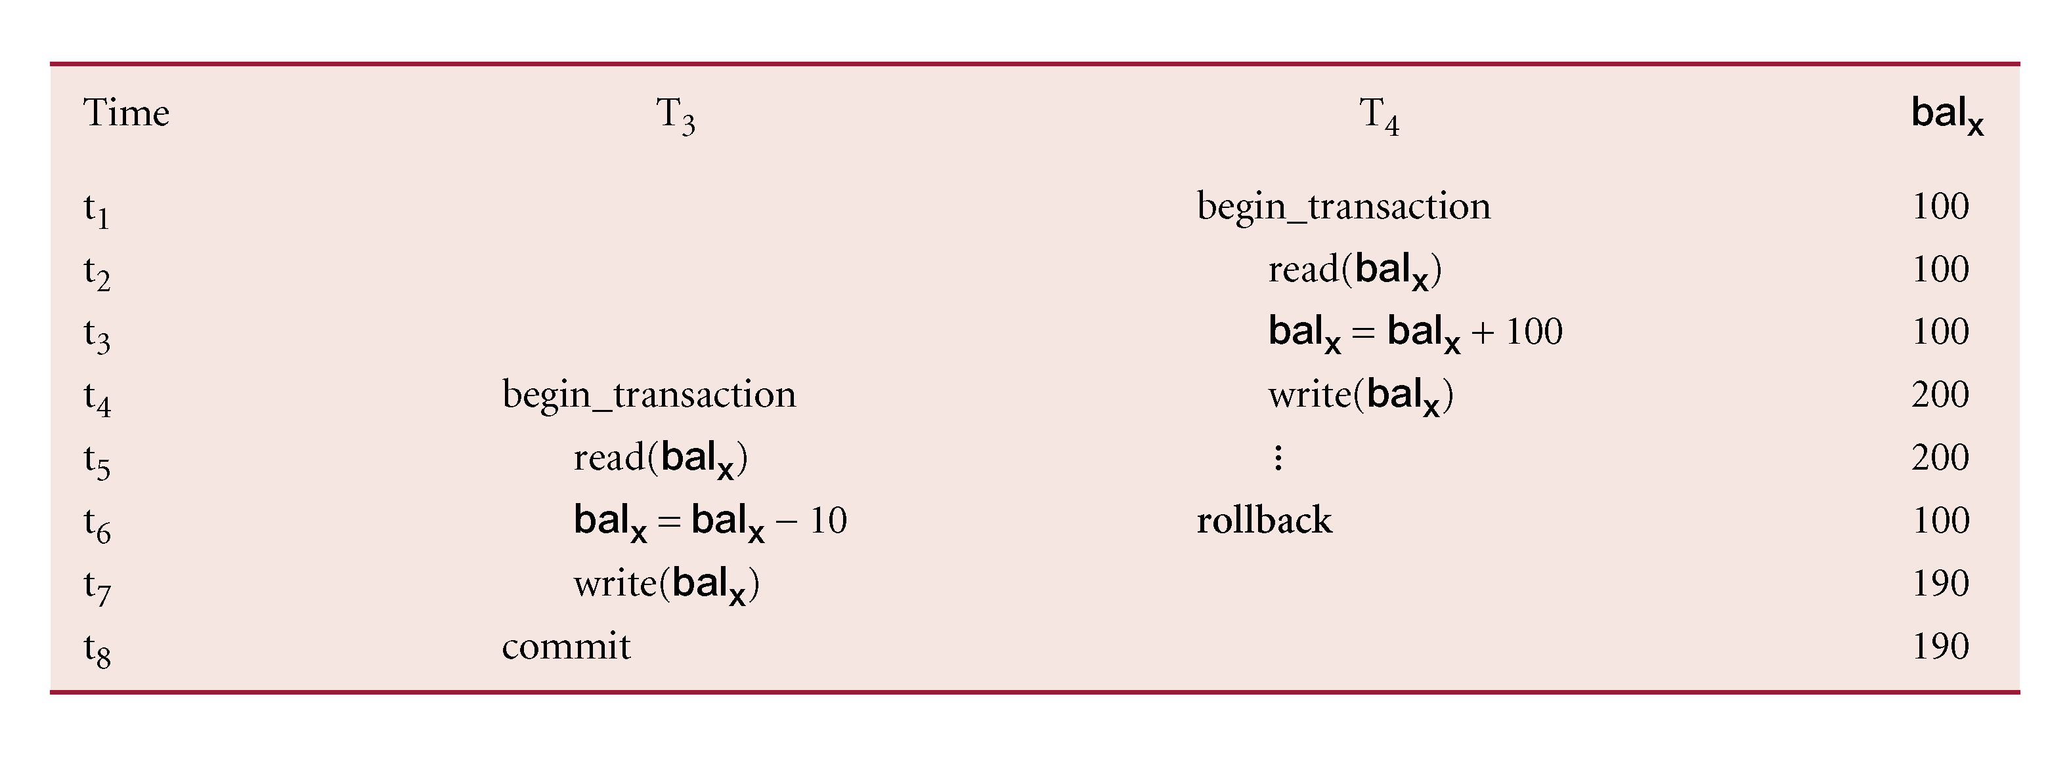
Uncommitted Dependency Problem
Problem avoided by preventing T₃ from reading bal_{x} until after T₄ commits or aborts.
Notes:
using the same initial value
for balance bal x as in the previous example. Here, transaction T 4 updates bal x to £200,
but it aborts the transaction so that bal x should be restored to its original value of £100.
However, by this time transaction T 3 has read the new value of bal x (£200) and is using
this value as the basis of the £10 reduction, giving a new incorrect balance of £190, instead
of £90. The value of bal x read by T 3 is called dirty data, giving rise to the alternative name,
the dirty read problem.
The reason for the rollback is unimportant; it may be that the transaction was in error,
perhaps crediting the wrong account. The effect is the assumption by T 3 that T 4 ’s update
completed successfully, although the update was subsequently rolled back. This problem
is avoided by preventing T 3 from reading bal x until after the decision has been made to
either commit or abort T 4 ’s effects.

Slide 15
Uncommitted Dependency Problem
T₄ updates bal_{x} to £200 but it aborts, so bal_{x} should be back at original value of £100.
T₃ has read new value of bal_{x} (£200) and uses value as basis of £10 reduction, giving a new balance of £190, instead of £90.

Slide 16
Inconsistent Analysis Problem
Occurs when transaction reads several values but second transaction updates some of them during execution of first.
Sometimes referred to as dirty read or unrepeatable read.

Slide 17
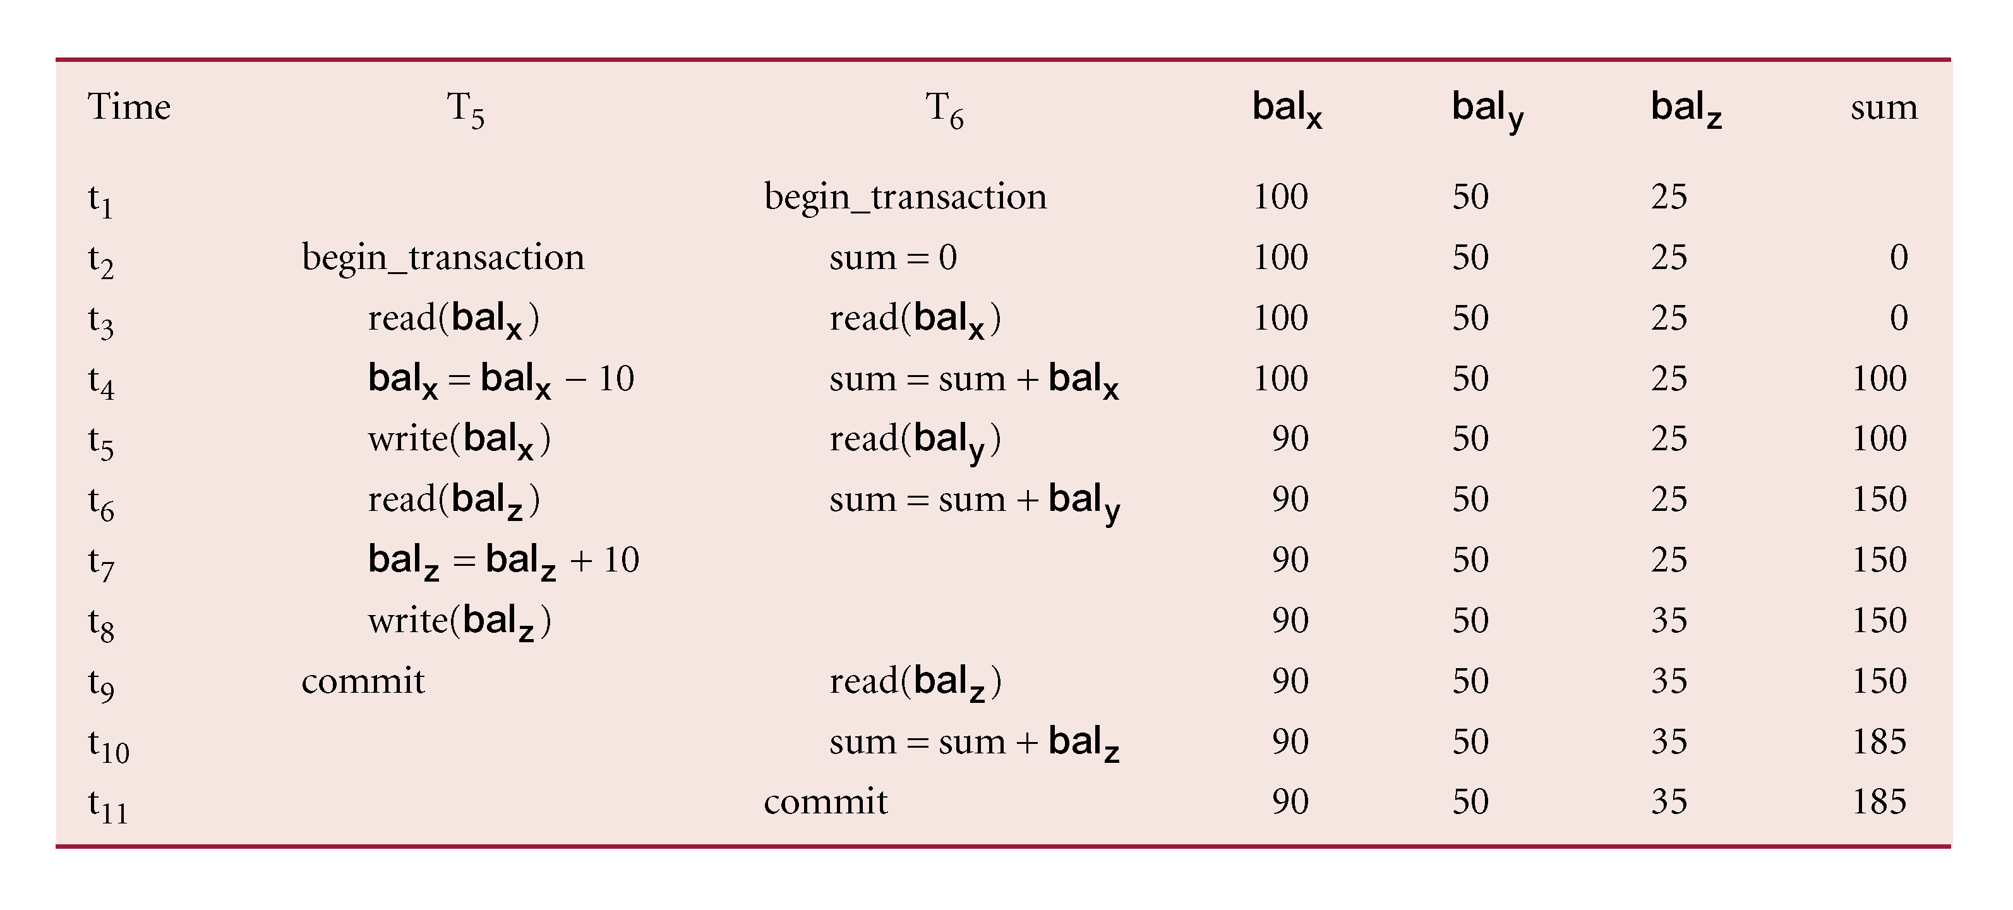
Inconsistent Analysis Problem
Problem avoided by preventing T₆ from reading bal_{x} and bal_{z} until after T₅ completed updates.
Notes:
T5 (trans 5): mainly it withdraw 10 from (balx) and add it to (balz)
Final value suppose to be 195
The problem of inconsistent analysis occurs when a transaction reads several values from
the database but a second transaction updates some of them during the execution of the
ﬁrst. For example, a transaction that is summarizing data in a database (for example,
totaling balances) will obtain inaccurate results if, while it is executing, other transactions
are updating the database. One example is illustrated in Figure 20.6, in which a summary
transaction T 6 is executing concurrently with transaction T 5 . Transaction T 6 is totaling
the balances of account x (£100), account y (£50), and account z (£25). However, in the
meantime, transaction T 5 has transferred £10 from bal x to bal z , so that T 6 now has the wrong
result (£10 too high). This problem is avoided by preventing transaction T 6 from reading
bal x and bal z until after T 5 has completed its updates.

Slide 18
Inconsistent Analysis Problem
T₆ is totaling balances of account x (£100), account y (£50), and account z (£25).
Meantime, T₅ has transferred £10 from bal_{x} to bal_{z}, so T₆ now has wrong result (£10 too high).

Slide 19
Serializability
Objective of a concurrency control protocol is to schedule transactions in such a way as to avoid any interference.
Could run transactions serially, but this limits degree of concurrency or parallelism in system.
Serializability identifies those executions of transactions guaranteed to ensure consistency.

Slide 20
Serializability
  Schedule
  Sequence of reads/writes by set of concurrent transactions.
  Serial Schedule
  Schedule where operations of each transaction are executed one after the other without any interleaved operations from other transactions.

Slide 21
Nonserial Schedule
Schedule where operations from set of concurrent transactions are interleaved.
Objective of serializability is to find nonserial schedules that allow transactions to execute concurrently without interfering with one another.
In other words, want to find nonserial schedules that are equivalent to some serial schedule. Such a schedule is called serializable.

Slide 22
Serializability
In serializability, ordering of read/writes is important:
(a) If two transactions only read a data item, they do not conflict and order is not important.
(b) If two transactions either read or write completely separate data items, they do not conflict and order is not important.
(c) If one transaction writes a data item and another reads or writes same data item, order of execution is important.

Slide 23
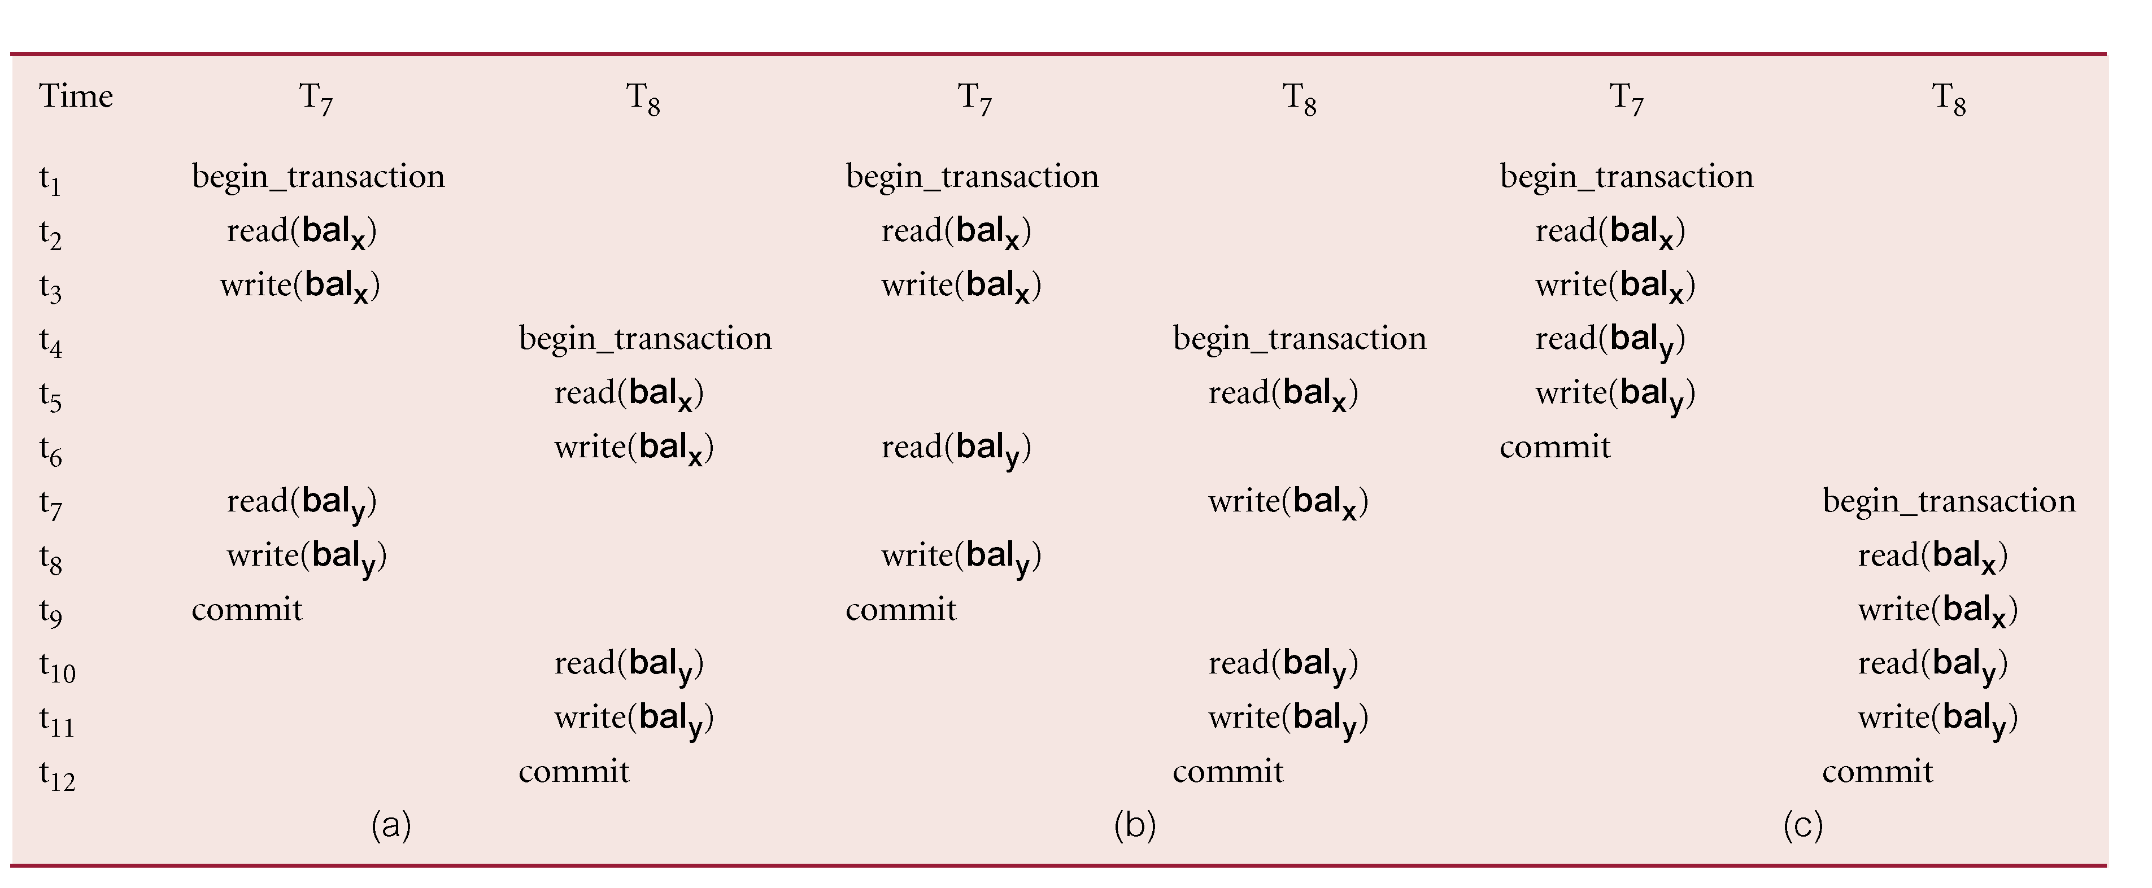
Example of Conflict Serializability
Notes:
Schedule S 3 is a serial schedule and, since S 1 and S 2 are equivalent to S 3 , S 1 and S 2 are
serializable schedules.
This type of serializability is known as conﬂict serializability. A conﬂict serializable
schedule orders any conﬂicting operations in the same way as some serial execution.

Slide 24
Serializability
Conflict serializable schedule orders any conflicting operations in same way as some serial execution.

Slide 25
Concurrency Control Techniques
Two basic concurrency control techniques:
  Locking,
  Timestamping.
Both are conservative approaches: delay transactions in case they conflict with other transactions.
Optimistic methods assume conflict is rare and only check for conflicts at commit.

Slide 26
Locking
Transaction uses locks to deny access to other transactions and so prevent incorrect updates.
Most widely used approach to ensure serializability.
Generally, a transaction must claim a shared (read) or exclusive (write) lock on a data item before read or write.
Lock prevents another transaction from modifying item or even reading it, in the case of a write lock.

Slide 27
Locking - Basic Rules
If transaction has shared lock on item, can read but not update item.
If transaction has exclusive lock on item, it can read and update item.
Reads cannot conflict, so more than one transaction can hold shared locks concurrently on same item.
Exclusive lock gives transaction exclusive access to that item.

Slide 28
Locking - Basic Rules
Some systems allow transaction to upgrade read lock to an exclusive lock, or downgrade exclusive lock to a shared lock.

Slide 29
Locking
 | S | X
S | true | false
X | false | False
T_{j}
T_{i}
Locks must be held for a duration of access
Notes:
S , S true because we allow two shared locks on the tuple

Slide 30
Two-Phase Locking (2PL)
Transaction follows 2PL protocol if all locking operations precede first unlock operation in the transaction.
Two phases for transaction:
  Growing phase - acquires all locks but cannot release any locks.
  Shrinking phase - releases locks but cannot acquire any new locks.

Slide 31
Two-Phase Locking (2PL)
The protocol has a growing phase and a shrinking phase
Ensures serialisability, but not the freedom from deadlocks
May seriously reduce parallelism
Growing phase
Shrinking phase
Number of locks acquired
Commit point

Slide 32
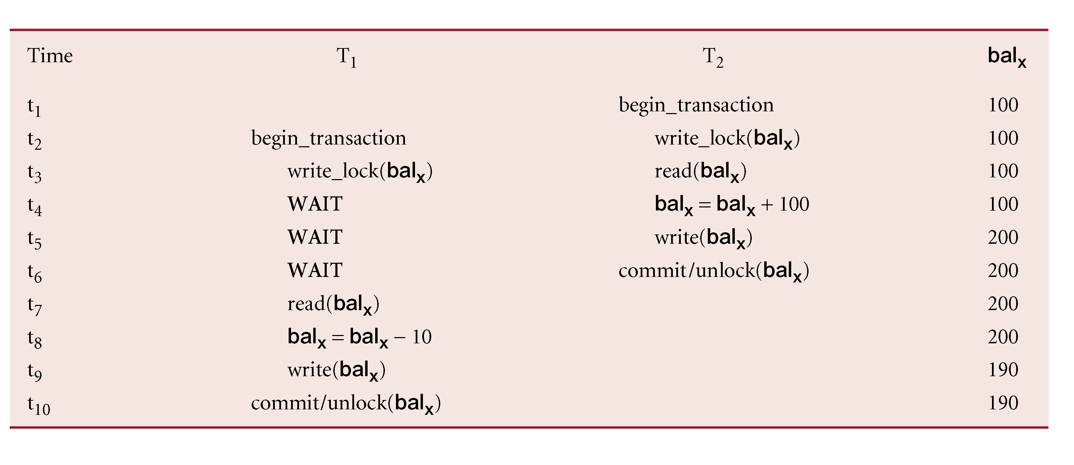
Preventing Lost Update Problem using 2PL
Notes:
A solution to the lost update problem is shown in Figure 20.15. To prevent the lost update
problem occurring, T 2 ﬁrst requests an exclusive lock on bal x . It can then proceed to read
the value of bal x from the database, increment it by £100, and write the new value back to
the database. When T 1 starts, it also requests an exclusive lock on bal x . However, because
the data item bal x is currently exclusively locked by T 2 , the request is not immediately
granted and T 1 has to wait until the lock is released by T 2 . This occurs only once the commit of T 2 has been completed.

Slide 33
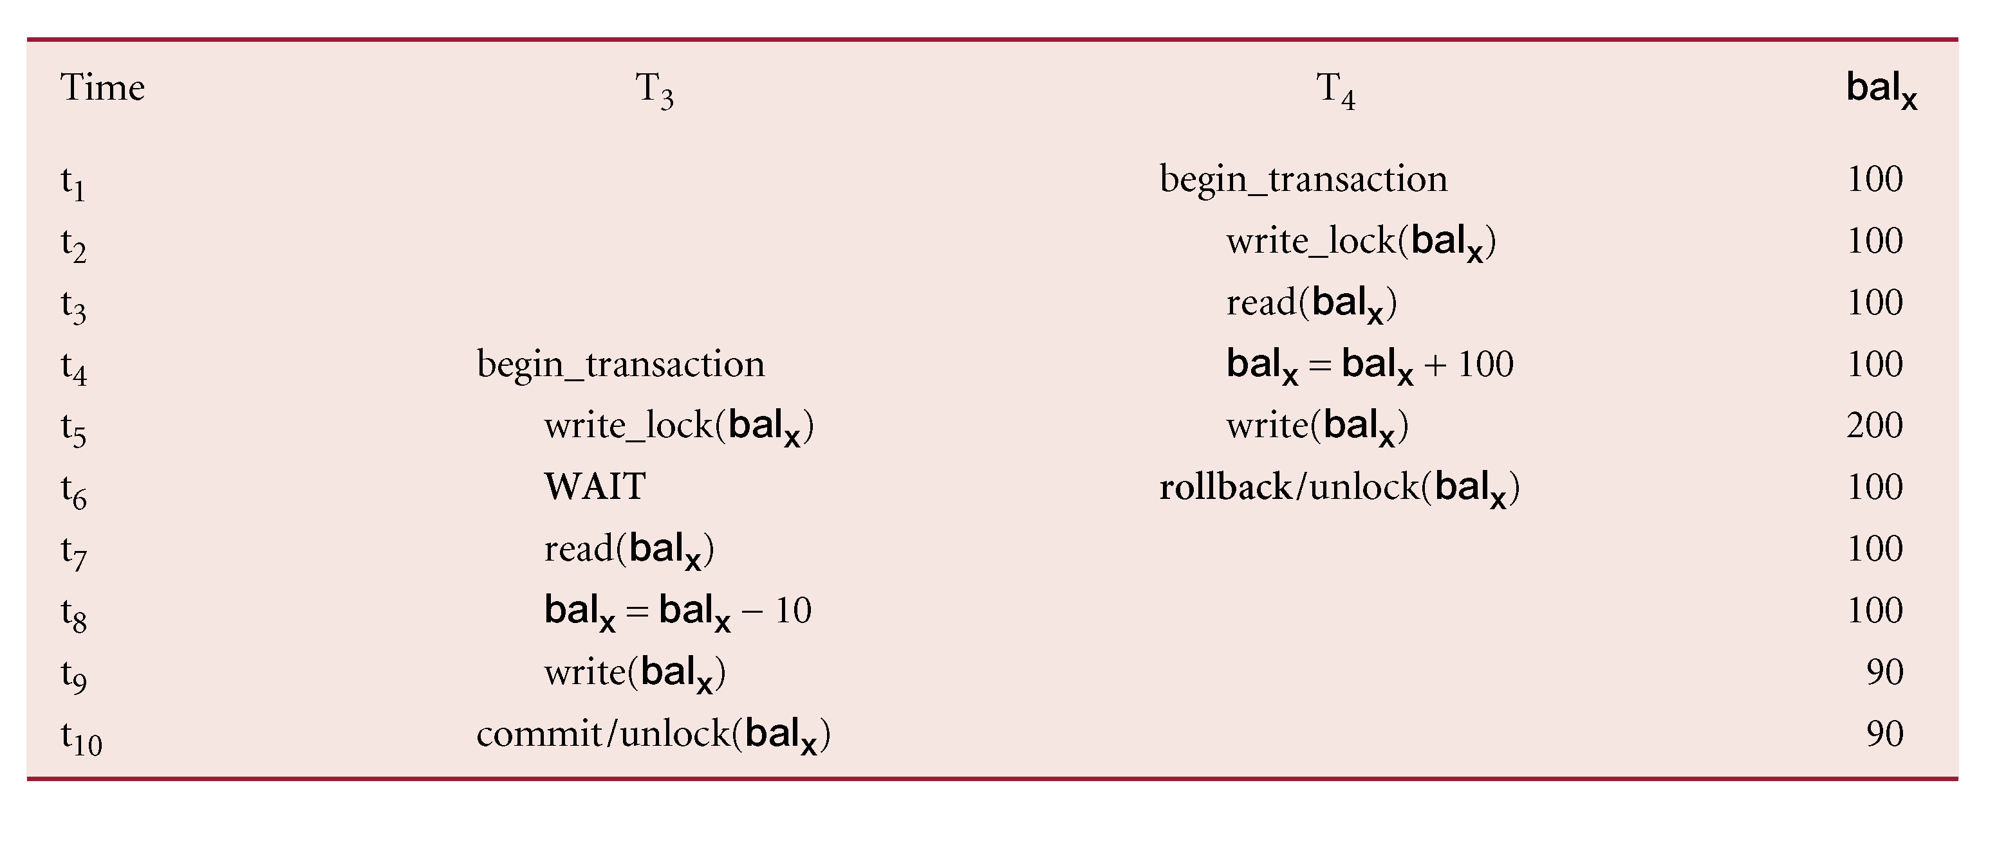
Preventing Uncommitted Dependency Problem using 2PL
Notes:
A solution to the uncommitted dependency problem is shown in Figure 20.16. To prevent
this problem occurring, T 4 ﬁrst requests an exclusive lock on bal x . It can then proceed to
read the value of balx from the database, increment it by £100, and write the new value
back to the database. When the rollback is executed, the updates of transaction T 4 are
undone and the value of bal x in the database is returned to its original value of £100. When
T 3 starts, it also requests an exclusive lock on bal x . However, because the data item bal x is
currently exclusively locked by T 4 , the request is not immediately granted and T 3 has
to wait until the lock is released by T 4 . This occurs only once the rollback of T 4 has been
completed.

Slide 34
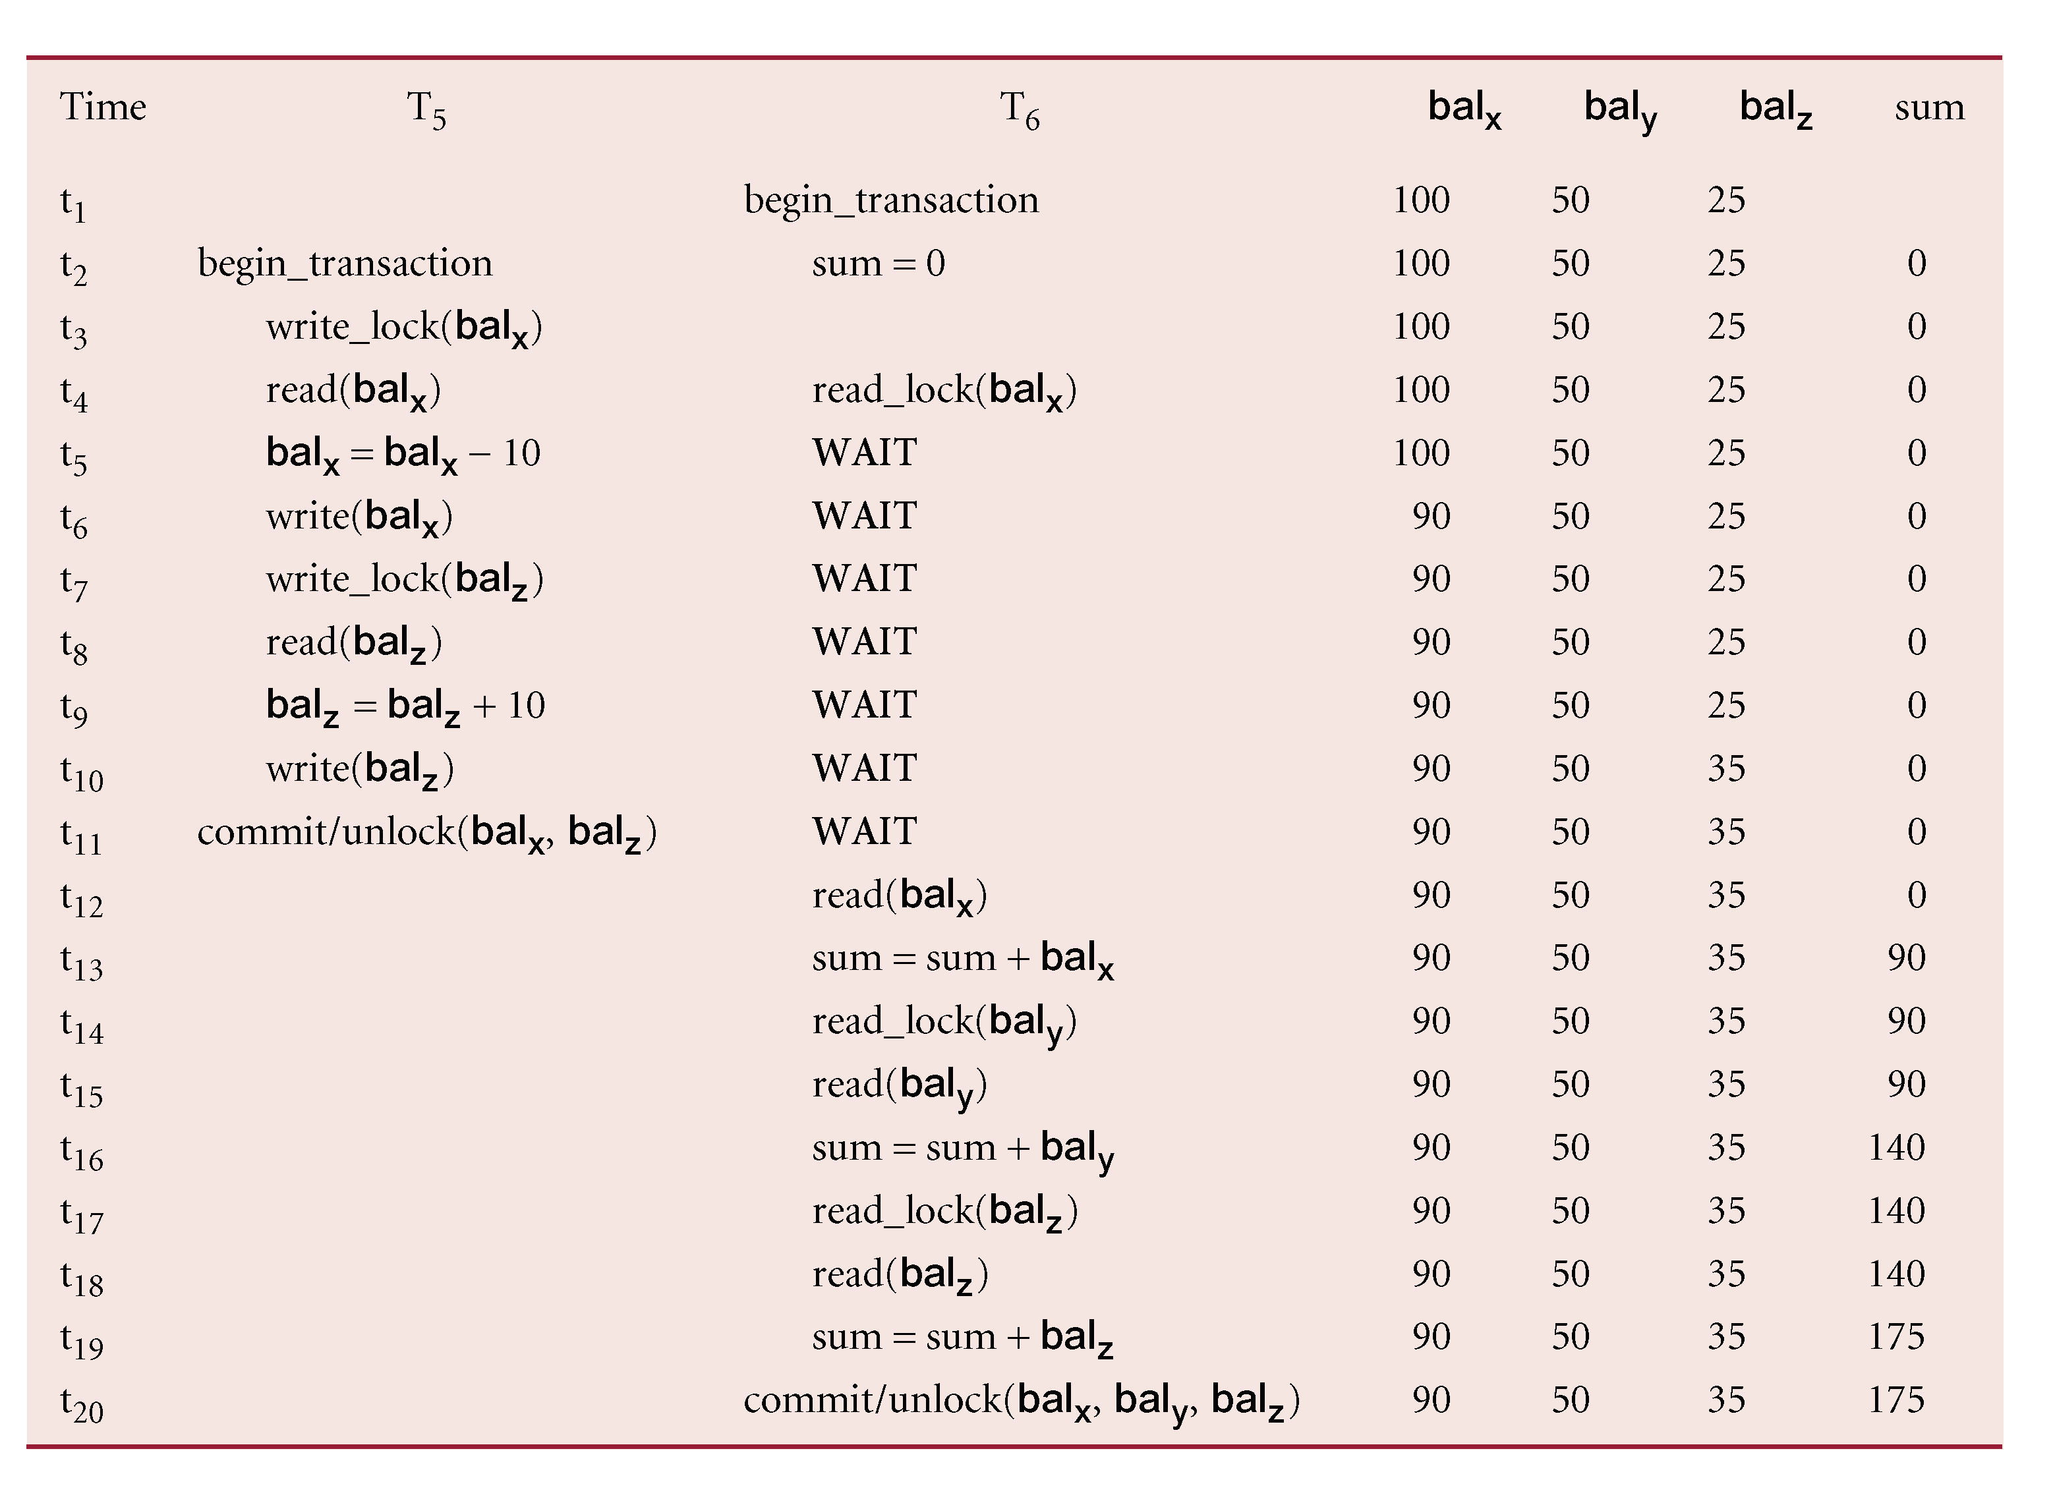
Preventing Inconsistent Analysis Problem using 2PL
Notes:
A solution to the inconsistent analysis problem is shown in Figure 20.17. To prevent this
problem occurring, T 5 must precede its reads by exclusive locks, and T 6 must precede its
reads with shared locks. Therefore, when T 5 starts it requests and obtains an exclusive lock
on bal x . Now, when T 6 tries to share lock bal x the request is not immediately granted and
T 6 has to wait until the lock is released, which is when T 5 commits.
It can be proved that if every transaction in a schedule follows the two-phase lock-
ing protocol, then the schedule is guaranteed to be conﬂict serializable (Eswaran et al.,
1976).

Slide 35
Database Recovery
Process of restoring database to a correct state in the event of a failure.
Need for Recovery Control
  Two types of storage: volatile (main memory) and nonvolatile.
  Volatile storage does not survive system crashes.
  Stable storage represents information that has been replicated in several nonvolatile storage media.

Slide 36
Types of Failures
System crashes, resulting in loss of main memory.
Media failures, resulting in loss of parts of secondary storage.
Application software errors.
Natural physical disasters.
Carelessness or unintentional destruction of data or facilities.

Slide 37
Transactions and Recovery
Transactions represent basic unit of recovery.
Recovery manager responsible for atomicity and durability.
If failure occurs between commit and database buffers being flushed to secondary storage then, to ensure durability, recovery manager has to redo (rollforward) transaction’s updates.

Slide 38
Transactions and Recovery
If transaction had not committed at failure time, recovery manager has to undo (rollback) any effects of that transaction for atomicity.
Partial undo - only one transaction has to be undone.
Global undo - all transactions have to be undone.

Slide 39
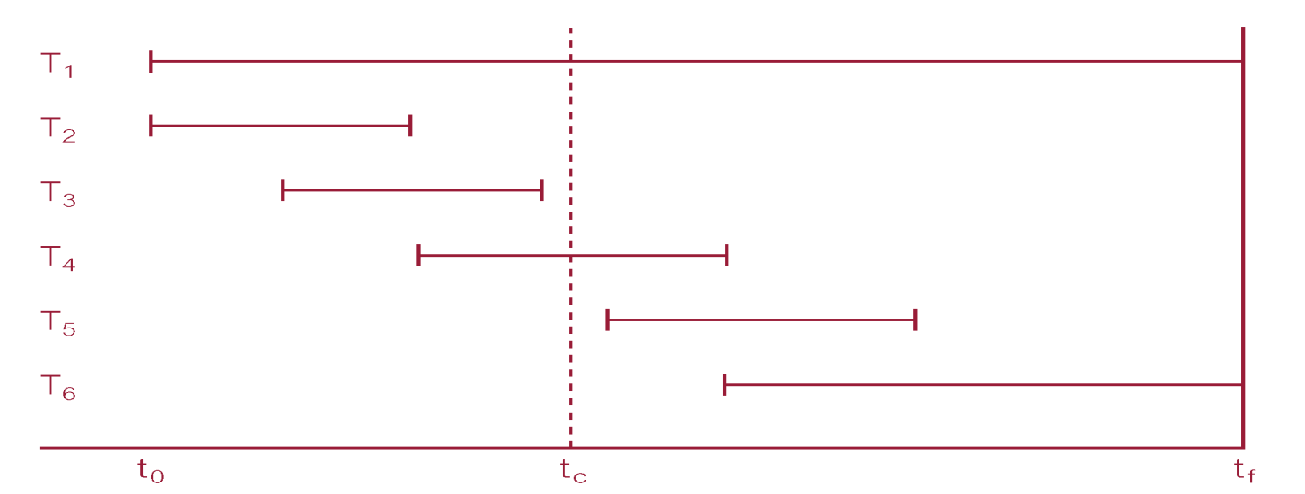
Example

Slide 40
Example
DBMS starts at time t₀, but fails at time t_{f}. Assume data for transactions T₂ and T₃ have been written to secondary storage.
T₁ and T₆ have to be undone. In absence of any other information, recovery manager has to redo T₂, T₃, T₄, and T₅. if there is no check point
Notes:
In case the checkpoint is not exists the recovery manager must
redo:
T2, T3, T4, and T5
Undo:
T1 and T6
In case the checkpoint exists the recovery manager must
redo:
T4 and T5
undo:
T1 and T6
T2 and T3 will not be effected since they have been committed earlier

Slide 41
Recovery Facilities
DBMS should provide following facilities to assist with recovery:
  Backup mechanism, which makes periodic backup copies of database.
  Logging facilities, which keep track of current state of transactions and database changes.
  Checkpoint facility, which enables updates to database in progress to be made permanent.
  Recovery manager, which allows DBMS to restore database to consistent state following a failure.

Slide 42
Log File
Contains information about all updates to database:
  Transaction records.
  Checkpoint records.
Often used for other purposes (for example, auditing).

Slide 43
Log File
Transaction records contain:
  Transaction identifier.
  Type of log record, (transaction start, insert, update, delete, abort, commit).
  Identifier of data item affected by database action (insert, delete, and update operations).
  Before-image of data item.
  After-image of data item.
  Log management information.

Slide 44
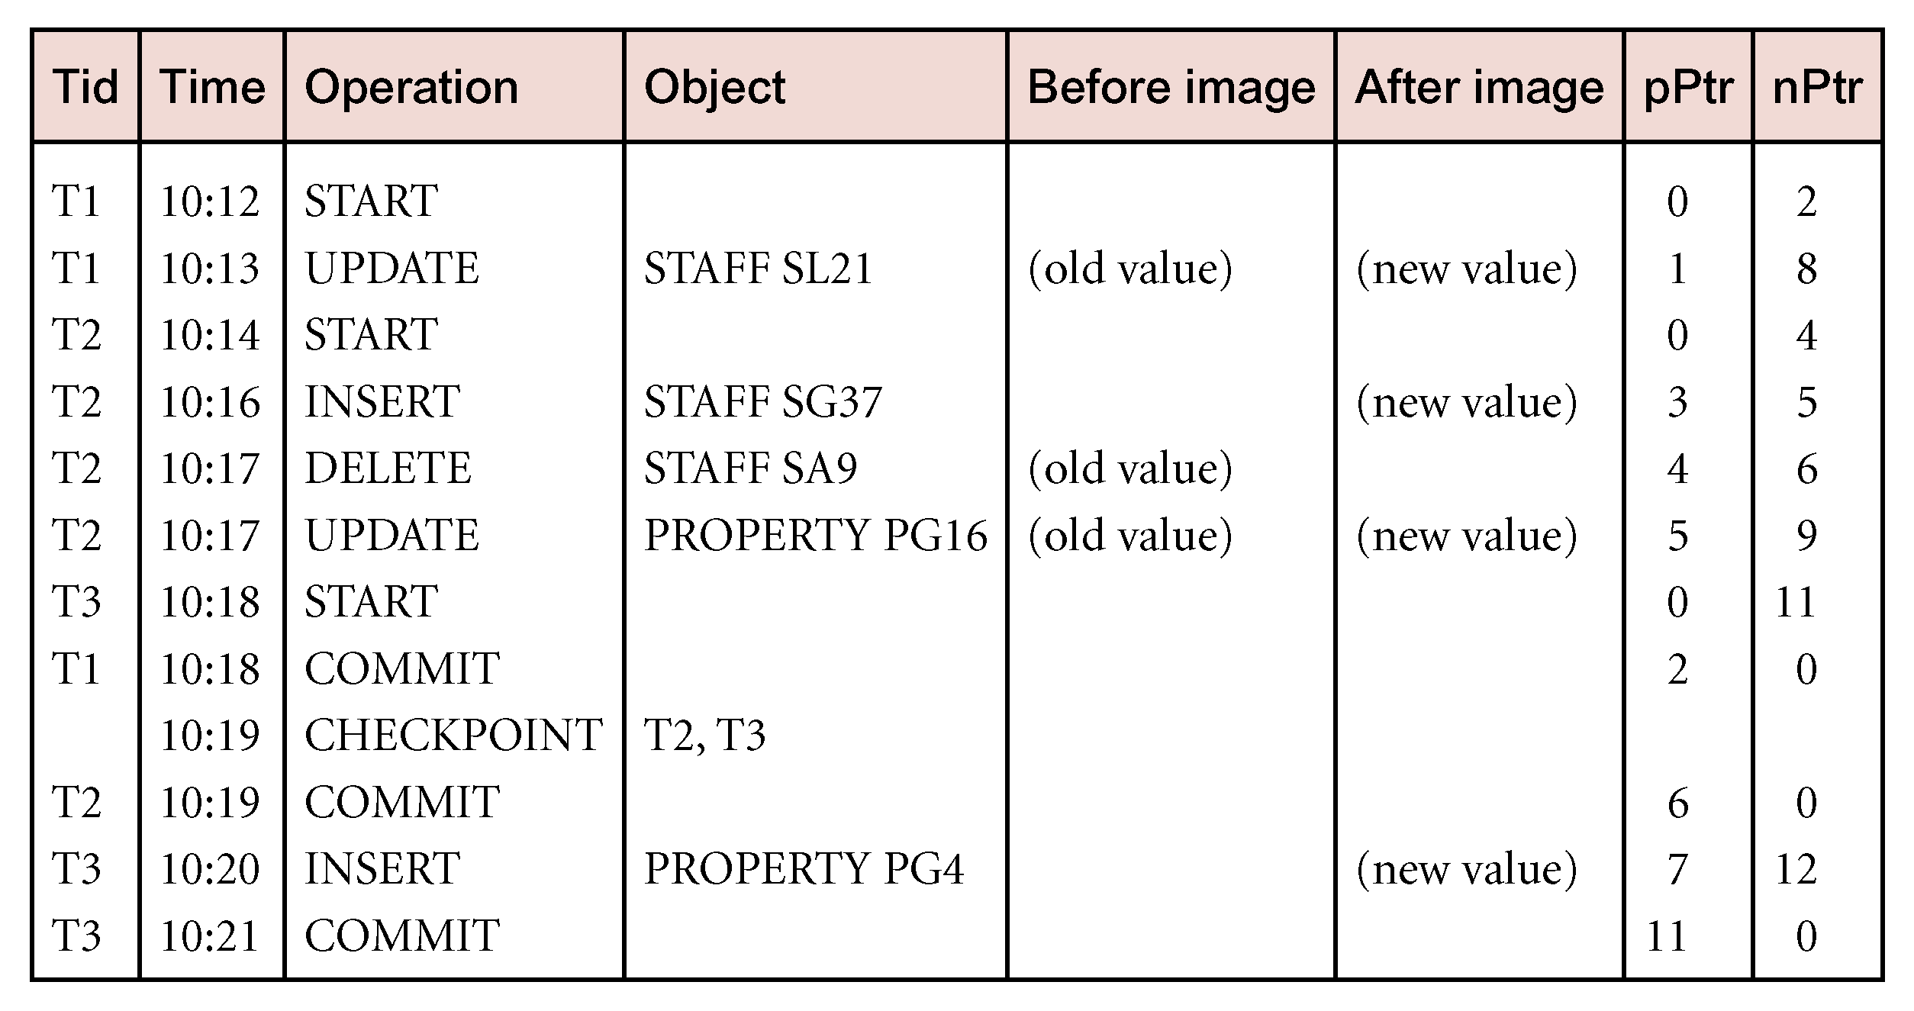
Sample Log File

Slide 45
Checkpointing
  Checkpoint
  Point of synchronization between database and log file. All buffers are force-written to secondary storage.
Checkpoint record is created containing identifiers of all active transactions.
When failure occurs, redo all transactions that committed since the checkpoint and undo all transactions active at time of crash.

Slide 46
Checkpointing
In previous example, with checkpoint at time t_{c}, changes made by T₂ and T₃ have been written to secondary storage.
Thus:
  only redo T₄ and T₅,
  undo transactions T₁ and T6.

Slide 47
Q & A

